Slide 1
Predicting Deforestation Increase in Amazonas
Oscar Menezes Rodrigues
Machine Learning with TensorFlow
OpenCampus
July 10, 2025

Slide 2
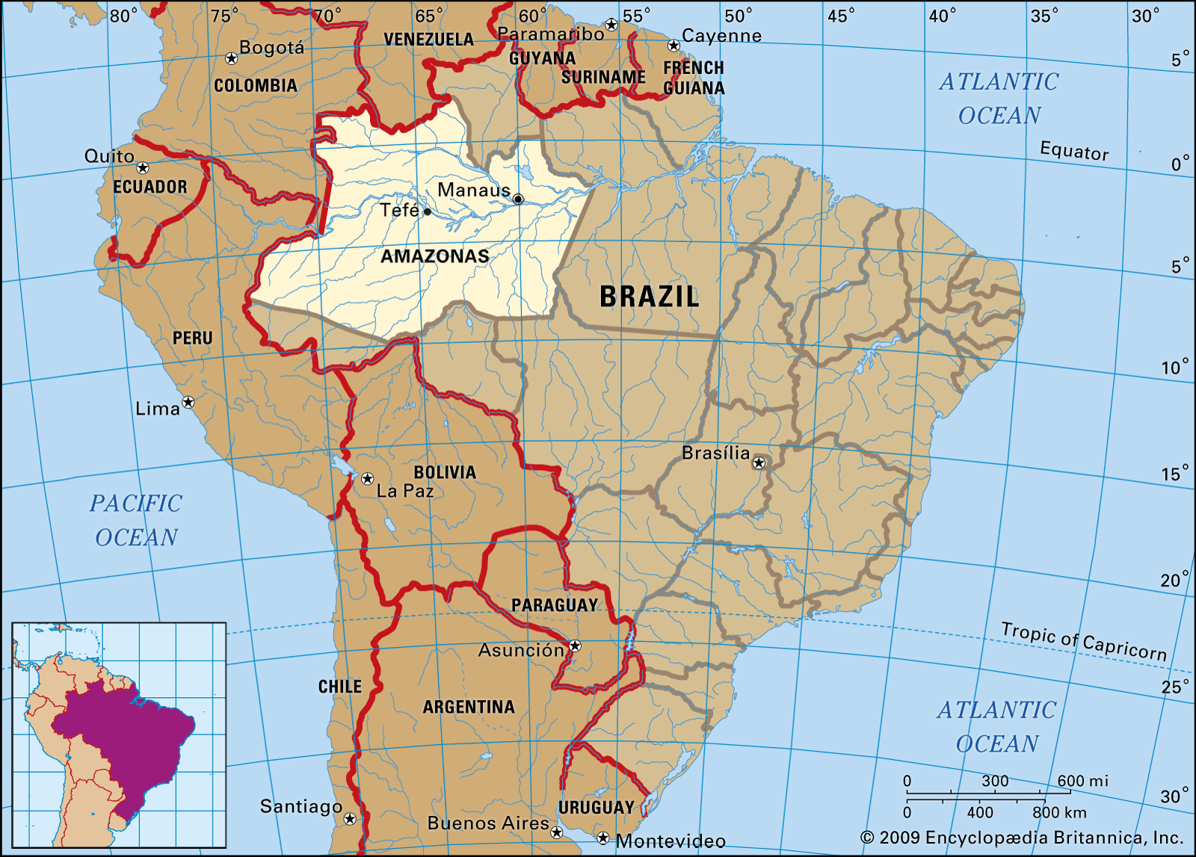
INTRODUCTION
Brazil's amazon rainforest: 60%
Amazonas state rainforest: 32%
14 times bigger than Germany
Natural forest: 84%
Water bodies: 12%
Urban infrastructure: 4%
54 municipalities

Slide 3
INTRODUCTION
Initial question: predicts which areas of the Amazon rainforest (delimited by the Brazilian state of Amazonas) are likely to experience deforestation in the following year
Type of task: Binary classification (deforestation: yes/no)
Dataset sources:
MapBiomas (land cover classes)
IBGE (brazilian municipalities borders)
PRODES (official deforestation history)

Slide 4
Literature Review
Soares-Filho: Random Forest on spatial features to predict deforestation
To simulate and predict deforestation trends in the Amazon using data-driven spatial modeling.
INPE study: Modeling the dynamics of deforestation in the Legal Amazon
To investigate spatial patterns of deforestation across the Brazilian Amazon and support environmental policy design.
MapBiomas: Annual land use and land cover mapping report (2024)
To produce annual, high-quality report of land use and land cover in Brazil for environmental monitoring.

Slide 5
Dataset Characteristics
MapBiomas:
Collected yearly raster files (2007–2022) showing land use in Amazonas.
Clipped them with IBGE municipality shapefile to calculate the number of pixels per land cover class.
Output: one CSV per year with land cover stats per municipality.
PRODES:
Loaded deforestation polygons (2007–2022).
Mapped each polygon to a municipality using a spatial join.

Slide 6
Dataset Characteristics
Counted deforestation events per municipality and year.
Created a binary target: 1 if deforestation occurred, 0 if not.
Final Dataset:
Merged both datasets so land cover from year Y–1 predicts deforestation in year Y.
Result:
one table with features (land cover) and target (deforestation) per municipality and year.

Slide 7
Dataset Characteristics
Samples: 1604 (municipality x year)
Missing Values: interpreted as absence (filled with 0)
Bias: Forest dominates (class imbalance)
Correlations: Forest (class 3) negatively correlated with pasture (class 15)
Class Code | Land Cover Type | Pixel Count
3 | Forest Formation | 9.8 million
6 | Agriculture | ~286k
11 | Mosaic (agriculture + pasture) | ~635k
15 | Pasture | 11k
24 | Urban infrastructure | 2k
33 | Water bodies | 1.6 million

Slide 8
Baseline Model
Logistic Regression: simple, interpretable, fast.
Selected Features: classes 3,6,11,15,24,33.
Evaluation:
Accuracy: 59%
F1 Score: 0.74
ROC-AUC: 0.48
Confusion Matrix: [5 , 9],
[72 , 113]
Reality Check: all municipalities face deforestation every year.
Code | Class
3 | Forest Formation
6 | Agriculture
11 | Mosaic (agriculture + pasture)
15 | Pasture
24 | Urban Infrastructure
33 | Water bodies

Slide 9
Neural Network Model
New question: to predict which municipalities are likely to experience deforestation increase in the next year
New variables: df_increase (deforestation increase: yes/no)
Architecture:
Input: 11 features
Hidden layers: [256 → 128 → 64]
Activations: LeakyReLU (with LayerNorm) + ReLU
Dropout: [0.4 → 0.3]
Output: 1 neuron, Sigmoid

Slide 10
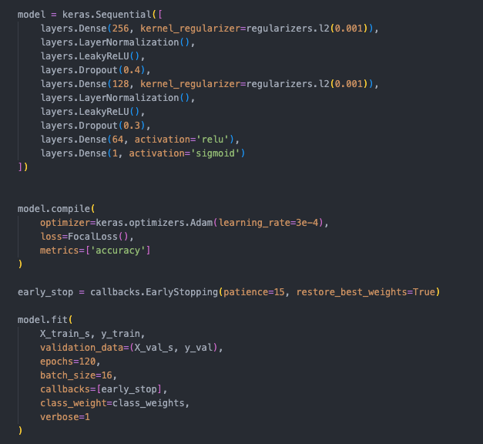
Neural Network Model
Loss: Focal Loss (for class imbalance)
Optimizer: Adam
Extras: Class weights, EarlyStopping (patience=15)
Selected Features: municipalities, years, 3,6,11,15,24,33 (land cover numerical variables), deforestation and df_increase.

Slide 11
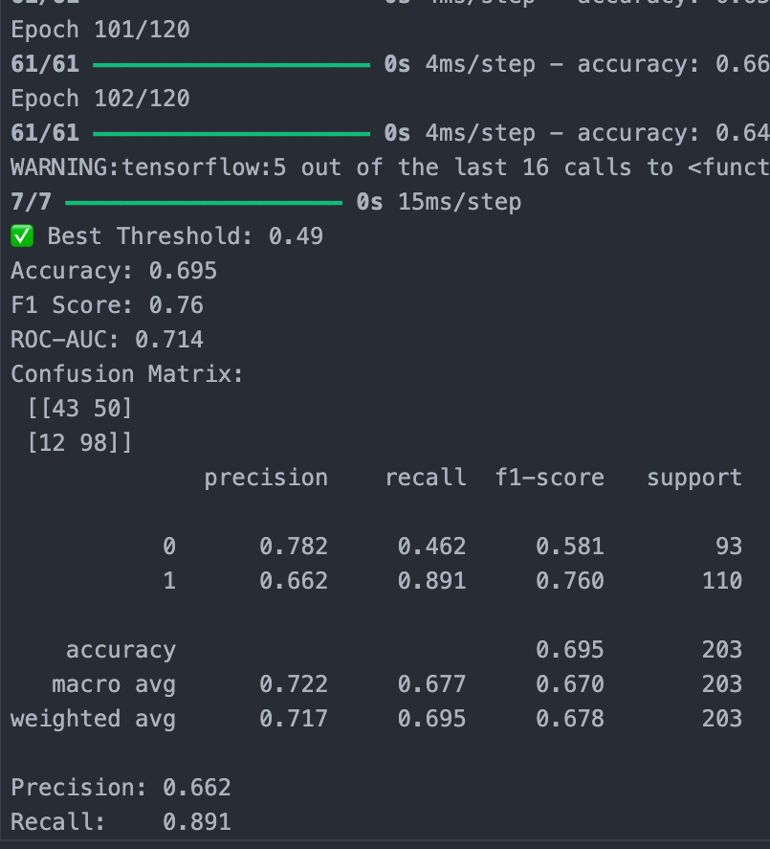
Neural Network Model
Evaluation:
Accuracy: 0695
F1 Score: 0.76
ROC-AUC: 0.714
Confusion Matrix: [43 , 50],
[12 , 98]

Slide 12
Model Comparison
The neural network outperforms the baseline in all metrics, especially ROC-AUC, indicating better discrimination between classes.
While the F1 improvement is modest, the gain in accuracy and AUC suggests the NN model generalizes better and captures complex patterns missed by logistic regression.
The baseline model was decisive for the reality check.
Metric | Logistic Regression | Neural Network
Accuracy | 0.59 | 0.69
F1 Score | 0.74 | 0.76
ROC-AUC | 0.48 | 0.71

Slide 13
Challenges & Errors
Heavy data and small data sample.
Class imbalance in the baseline model
LightGBM model.
Possible features:
Climate
Protected areas
Population density
proximity to IBAMA station

Slide 14
Thank you!
Q&A

